Slide 2
FIC – Financial Intelligence Centre
Financial Intelligence Centre Act, 2001 (Act No. 38 of 2001) (the FIC Act)
And amendments Dec 2022
Money laundering (ML), Terrorist financing (TF) and Proliferation Financing (PF)
Compliance and Sanctions
Accountable Institutions
Failure to register with the Centre or failure to provide or update any information in terms of section 43B of the FIC Act can lead to administrative sanctions in terms of section 61A of the FIC Act
financial penalty of up to R10 million for a natural person or R50 million for a legal person.

Slide 3
TRUST AND COMPANY SERVICE PROVIDERS
A trust and company service provider (TCSP) is listed in item 2 of Schedule 1 of the FIC Act as an accountable institution.
A “trust and company service provider (TCSP)” is any person in the ordinary course of business who assists their client in the creation, operation and management of an external company, a foreign company, a close corporation or a trust. This includes attending to the registration of the business entity with the relevant authority.
Organisations that provide the services of a TCSP will be considered as an accountable institution, regardless of whether their employees are auditors, accountants or other professionals.
Given the unique nature of the services offered by TCSPs, they are susceptible to abuse by entities seeking to misuse corporate structures to facilitate the movement of illicit funds. There are several listed money laundering (ML), terrorist financing (TF) and proliferation financing (PF) risk indicators that can be considered by TCSPs
The above is from the Public Compliance Communication guidelines.

Slide 4
What needs to be done
Register
( Due date was 21 March 2023)
Risk Management and Compliance Program (RMCP)
The systems, policies, procedures and controls to manage ML/TF risks as well as the levels of due diligence must be documented in an RMCP.
Perform the Due Diligence as contained in the RMCP
On-Boarding
Transaction
Updated TFS list
Record Keeping

Slide 5
On-Boarding
New clients and all existing clients to be treated as new clients initially
Establish and verify client’s identity
Supplementary Documentation
Client declarations
Due diligence
This is not a one size fits all
Dependant on your specific practice, size, type of clients, services etc

Slide 6
On-Boarding – Clients identity
For a Natural person
Name
Identity / registration
Addresses
Contact details
Registrations with authorities and regulatory bodies
Tax Number

Slide 7
On-Boarding – Clients Identity
In addition to the above, for a legal person (Company, CC , Trust)
Attributes to Establish and verify Legal person’s identity
• The name under which the legal person has been incorporated;
• Its form, e.g. whether it is a company or a close corporation;
• The registration number under which it is incorporated, if applicable;
• The address of its registered office;
• Its directors or members, as may be applicable;
• Its ownership and control structure (shareholders)
• Its senior management e.g. its chief executive officer;
• Its trading name if it is different from the name under which it has been incorporated;
• Its business address if it is different from the address of its registered office; and
• Its income tax or value added tax numbers.
Furthermore, an accountable institution must also establish who the beneficial owner of the legal person is and take reasonable steps to verify the beneficial owner’s identity
More on this later

Slide 8
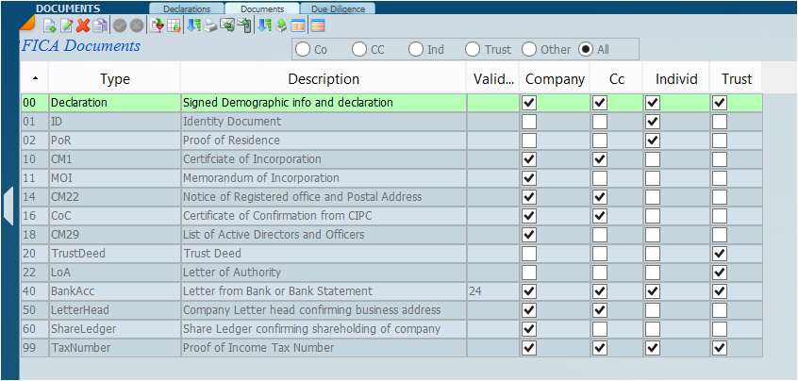
On-Boarding Supplementary Documentation
Identity / registration
Addresses
Contact details
Registrations with authorities and regulatory bodies
Identity / registration

Slide 9
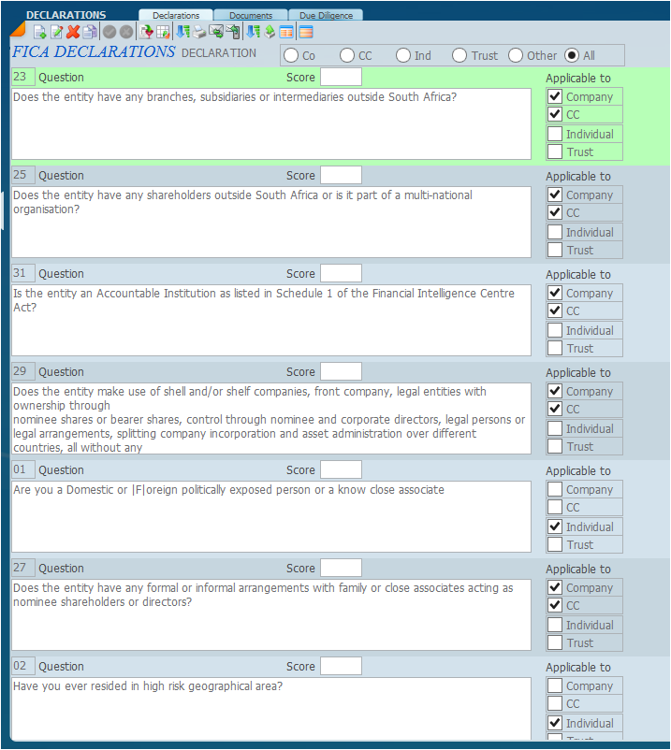
On-Boarding - Client Declarations

Slide 10
Due Diligence On-Boarding and Transactions

Slide 11
TFS – Targeted Financial Sanctions List
This list is updated periodically and every FIC client of yours must be scrutinised against this list as and when it is updated

Slide 12
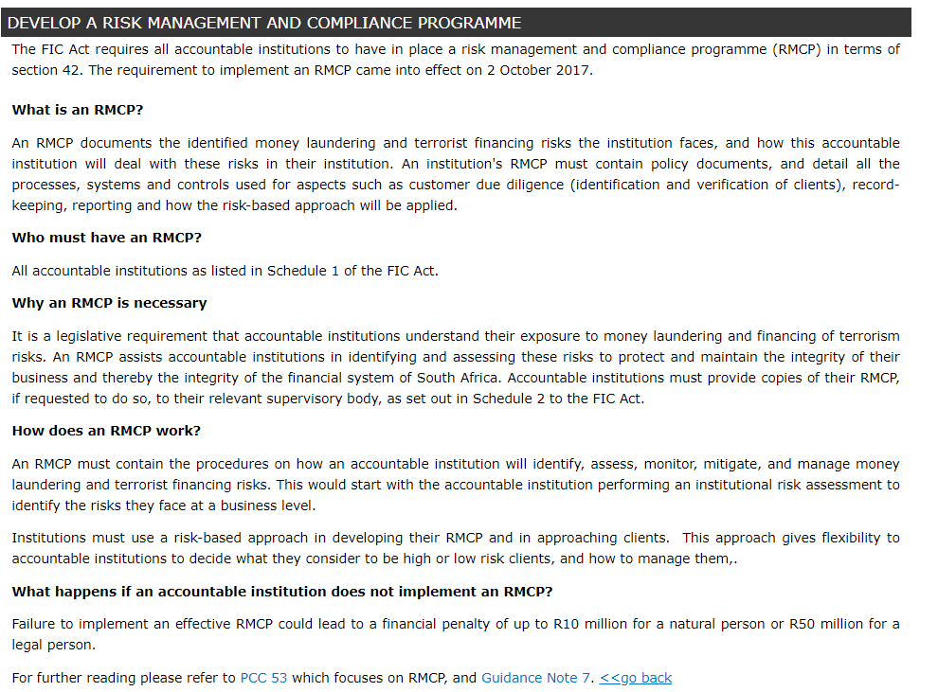
RMCP – Risk Management and Compliance Program
https://www.fic.gov.za/amendments/Pages/riskmanagement.aspx

Slide 13
RMCP
Section 42 of the FIC Act places an obligation on accountable institutions to develop, document, maintain and implement a RMCP
Needs to apply a risk based approach
Commensurate with the size of the practice and nature of your clients and the services offered.
Ie could be relatively simple or fairly complex
Indicate the compliance officer
Information gathered ito client identity and demographics
Documents gathered and stored to verify
Declarations requested
Due diligence details
Contents and procedures must be communicated to all staff
Available for reference
Indicate Record keeping, where , how and what medium
Reviewed regularly

Slide 14
Record Keeping
Section 22 of the FIC act provides for an obligation to keep records
Records of the following must be kept
Information re client identification (demographics)
Documentation
Client declarations
transactions
due diligence
Records must include date, references and person who conducted the due diligence and any other pertinent info to enable a trace
Records must be easily accessible by the practice.
Must be ready available to the FIC when required
Must be able to be reproduced in a legible format (ie reports)
Must be tamper proof and prevent unauthorised access
Be kept for a minimum period of 5 years
All elements of record keeping must be detailed in the RMCP

Slide 15
SHOW SOFTWARE

Slide 16
Sky - FICA
Separate additional module
A FICA client is a Tax or Sec client as well as sub links directors/shareholders/members/trustees/beneficiaries etc
It is unique, eg only once irrespective if director of multiple companies
Have to use other module specifically SkySec

Slide 17
Sky - FICA
Price
R 2200.00 once of initiation or setup fee
And
R 18.00 per FICA client per annum
Or
R 1.50 per FICA client per month
All prices are exclusive of VAT

