Slide 1
OCTOBER
FINANCIAL EMIGRATION &
THE FOREIGN EMPLOYMENT INCOME EXEMPTION
PRESENTED BY:
MARTIN BEZUIDENHOUT

Slide 2
AGENDA
1
Introduction
2
South African Tax Law
3
Tax Residency Rules
4
The New Financial Emigration
5
SARS Audit Examples
6
Closing comments and Q&A

Slide 3
“
Judge Dennis M Davis, Chairman Davis Tax Committee, is quoted saying:
“In summary, the second edition of this carefully considered book (which not only deals with all the various tax implications of immigration/emigration but the taxation of residents working offshore) remains an invaluable guide to an increasingly complex set of tax challenges. Given these changes, it is an even more significant addition to our body of tax literature and will remain essential reading for anyone advising his or her client with regard to the tax consequences of migration and non-resident accruals.”
OCTOBER 2022 | ALL RIGHTS RESERVED
HOSTED BY:

Slide 4
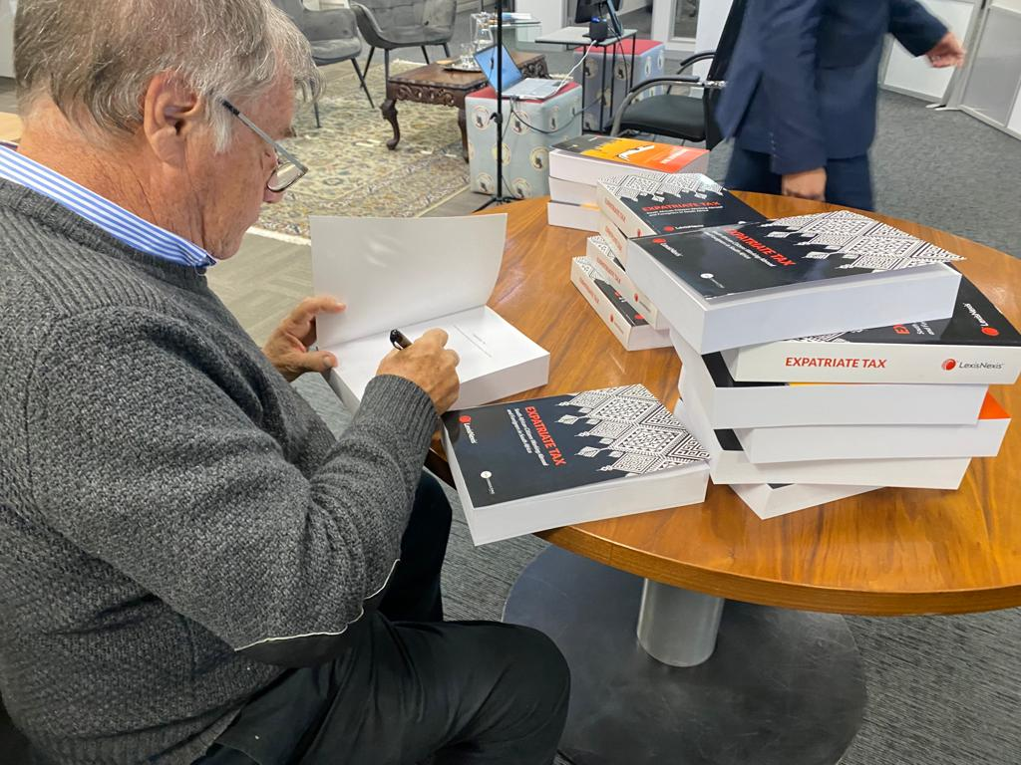
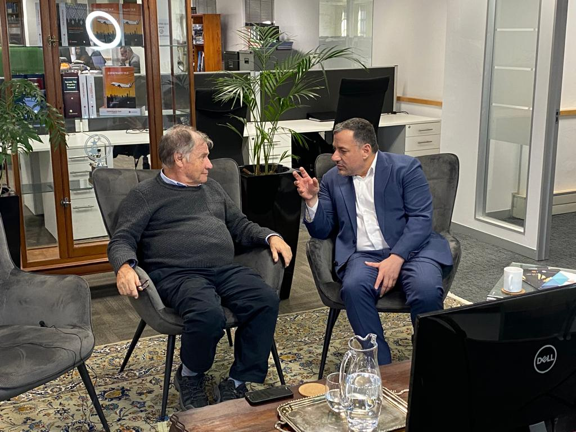
INTERNATIONAL TAX STRUCTURES| HYBRID EVENT

Slide 5
THE SPEAKER
MARTIN BEZUIDENHOUT
Admitted Attorney: Expatriate Tax
Martin Bezuidenhout holds a BCom Law degree and LLB degree from North West University and is an admitted Attorney and Conveyancer of the High Court of South Africa. Martin is an integral member of Tax Consulting SA’s Expatriate Tax division. He diligently consults on the more complex areas of expatriate taxation and in particular the application of Section 10(1)(o)(ii), and the cessation of tax residency. Martin recently represented Tax Consulting SA at the 2022 SAIT Tax Indaba, where he was part of a panel that discussed “Ordinary emigration and taxing grey hairs.”
OCTOBER 2022 | ALL RIGHTS RESERVED
HOSTED BY:

Slide 6
SAME PAGE ON READING LAW | BURDEN OF PROOF
102. Burden of proof - (1) A taxpayer bears the burden of proving – (a) that an amount, transaction, event or item is exempt or otherwise not taxable;
that an amount or item is deductible or may be set off;
the rate of tax applicable to a transaction, event, item or class of taxpayer;
that an amount qualifies as a reduction of tax payable;
that a valuation is correct; or
whether a ‘decision’ that is subject to objection and appeal under a tax Act, is incorrect.
129. Decision by tax court - (1) The tax court, after hearing the ‘appellant’s’ appeal lodged under section 107 against an assessment or ‘decision’, must decide the matter on the basis that the burden of proof as described in section 102 is upon the taxpayer. (emphasis added)
OCTOBER 2022 | ALL RIGHTS RESERVED
HOSTED BY:

Slide 7
BURDEN OF PROOF | CASE LAW EXAMPLES
In Bloch v SIR 1980 42 SATC 7 at 14, the court confirmed the onus on a taxpayer – “discharged on the ordinary basis applied in civil cases, that is, on a balance of probabilities”.
The Special Court in ITC 43 held that – “in the case of all things being equal we are bound to decide in favour of the Commissioner. Therefore, we are of opinion that the assessment must be confirmed.”
(emphasis added)
OCTOBER 2022 | ALL RIGHTS RESERVED
HOSTED BY:

Slide 8
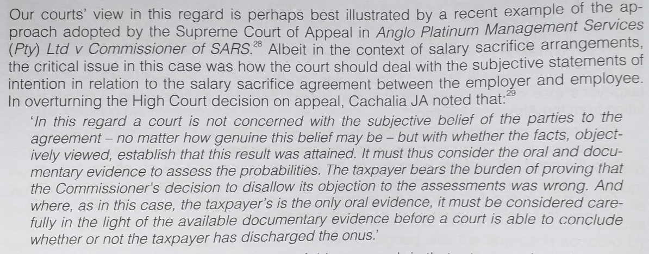
SUPREME COURT OF APPEAL | LAW CONSIDERS “OBJECTIVE” & NOT “SUBJECTIVE”
OCTOBER 2022 | ALL RIGHTS RESERVED
HOSTED BY:

Slide 9
TAX RESIDENCY RULES
Residents
Taxed on worldwide income – does not matter where it arose.
CGT on disposal of all assets, situated anywhere worldwide.
Non-Residents
Taxed on South African source income only.
CGT only on disposal of fixed property and property-rich shares in RSA.
No world-wide tax even on remittances.
No donations tax and / or estate duty.
OCTOBER 2022 | ALL RIGHTS RESERVED
HOSTED BY:

Slide 10
SA TAX RESIDENCY TEST
Ordinarily Resident test – intention test.
Is South Africa your permanent and / or “real” home?
Do you intend to permanently return to South Africa in future?
Roadmap: Will you be able to permanently reside elsewhere?
Physical Presence test – days test.
More than 91 days in current year of assessment;
More than 91 days in each of the previous 5 years of assessment; and
915 days in aggregate over the 5 year period.
The Physical presence test only applies where the ordinarily resident test does not apply at any time during the relevant year of assessment.
OCTOBER 2022 | ALL RIGHTS RESERVED
HOSTED BY:

Slide 11
WHAT IS THE FOREIGN EMPLOYMENT INCOME EXEMPTION?
Applies only to South African tax residents.
Applies only to employment income in relation to non-RSA workdays.
Exemption for up to R1.25 million of gross foreign employment income.
I.E., excl. tax & deductions, and incl. bonuses, allowances & benefits.
Requirements:
Taxpayer must be outside of RSA for more than 183 full days;
Of which, more than 60 full days are continuous;
Within any 12-month period.
Any 12-month period starting or ending in the year of assessment applies, and the 12-month periods may overlap.
OCTOBER 2022 | ALL RIGHTS RESERVED
HOSTED BY:

Slide 12
EXEMPTION RULE | SUMMARY
Exempts your foreign income FULLY before 1 March 2020, UP TO R1 250 000 after 1 March 2020.
Exemption only applicable to tax residents;
Employment income only (not independent contractors);
More than 183-and-60 days physically absent from RSA;
Only income from employment services outside RSA are exempt;
Must submit tax return and claim tax exemption under correct sections; and
SARS almost always audits exemption and requires supporting documents.
OCTOBER 2022 | ALL RIGHTS RESERVED
HOSTED BY:

Slide 13
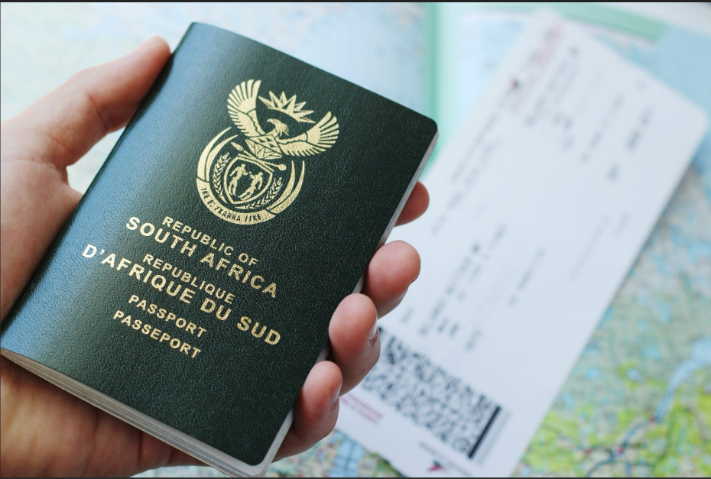
CITIZENSHIP vs TAX RESIDENCY?
Does giving up your SA Passport exempt you from SA Taxation?
OCTOBER 2022 | ALL RIGHTS RESERVED
HOSTED BY:

Slide 14
FINANCIAL EMIGRATION | WHAT IS IT ?
Financial Emigration has been recognized and confirmed by SARS as a process in which one can cease their tax residency in South Africa, should one have a permanent intention to reside outside of South Africa on a permanent basis.
Once off process.
Backdated financial emigration.
Spouses both need to cease tax residency- conflict of intent;
Keep all assets in South Africa after financial emigration.
Able to financially emigrate without being a permanent resident or citizen of another country.
By Financially Emigrating you are not cutting ties with SARS, you do continue to submit returns to SARS to declare your local earned income.
De-registration of your SA tax number is not automatically done.
Only once you dispose of all your assets such as bank accounts, properties, trusts, shares and policies, then you can deregister for tax in its entirety and not need to submit any tax returns.
OCTOBER 2022 | ALL RIGHTS RESERVED
HOSTED BY:

Slide 15
FINANCIAL EMIGRATION RULE CHANGE | BUDGET SPEECH 2020
OCTOBER 2022 | ALL RIGHTS RESERVED
HOSTED BY:

Slide 16
TAX NON-RESIDENT CONFIRMATION LETTER SARS
= TIMELINE
July
2022
B
Feb
2022
B
Removal
of the ‘tick-box’ for tax non-residency declaration
on annual ITR12 tax return.
B
Additional RAV01 status update & verification requirements introduced by SARS.
Early
2022
B
Mid
2021
SARS rejection
of Non-Resident applications; increased audit
activity.
B
SARS Non-Resident
Tax Status Confirmation Letter.
1 Mar
2021
Nov
2019
SARB financial emigration changes. No MP336(b). SARS Emigration Tax Clearance Status pin expires after 1 year.
B
B
SARS Emigration Tax Clearance Status Pin.
FE Two-part process through SARB/SARS. Bank & tax status changes to non-resident.
B
1 Mar
2001
1999
B
Tax
Residency
(worldwide tax)
SARB
Emigration
MP336(b).

Slide 17
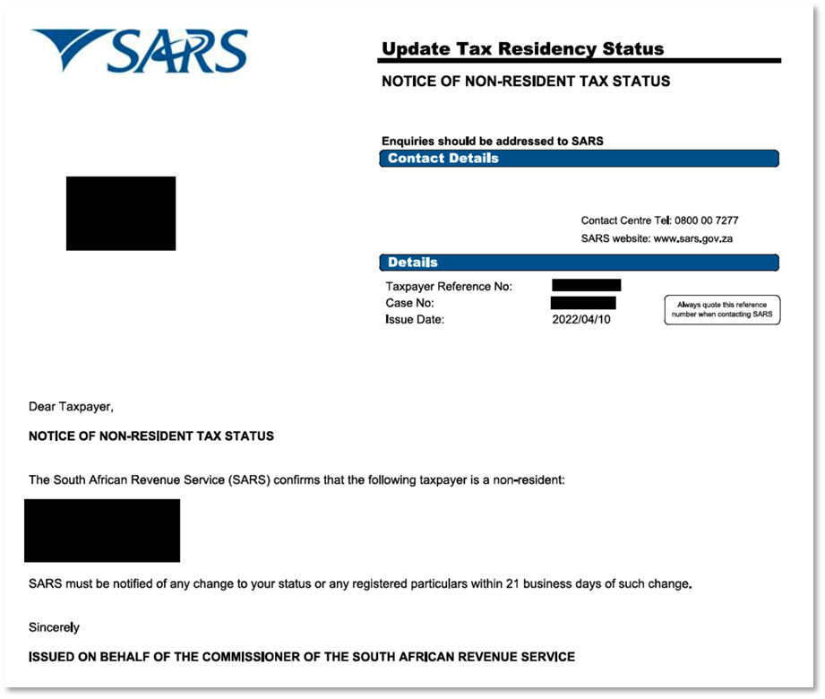
RESIDENCY CONFIRMATION
OCTOBER 2022 | ALL RIGHTS RESERVED
HOSTED BY:

Slide 18
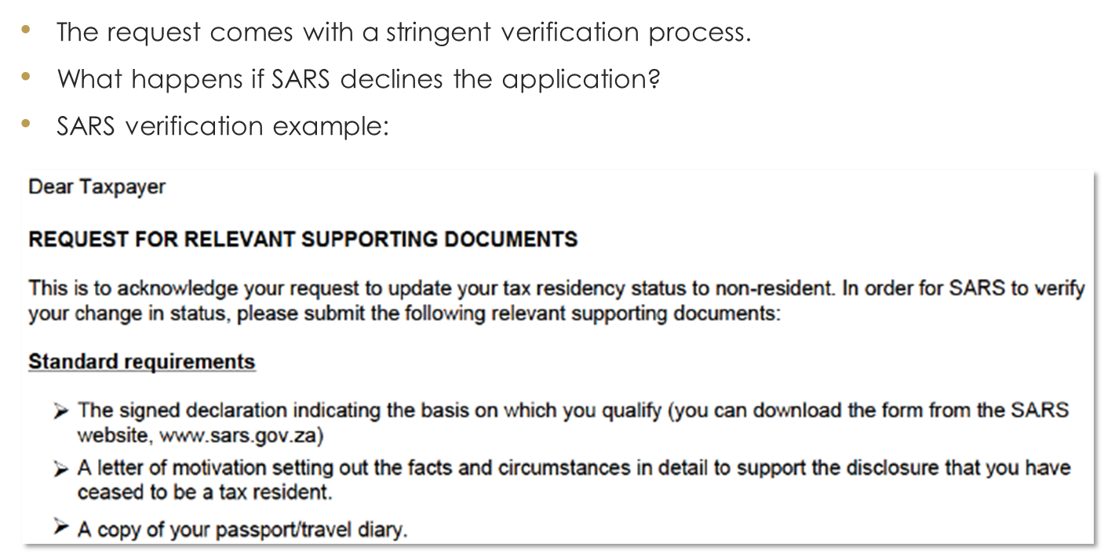
STRINGENT VERIFICATION PROCESS
OCTOBER 2022 | ALL RIGHTS RESERVED
HOSTED BY:

Slide 19
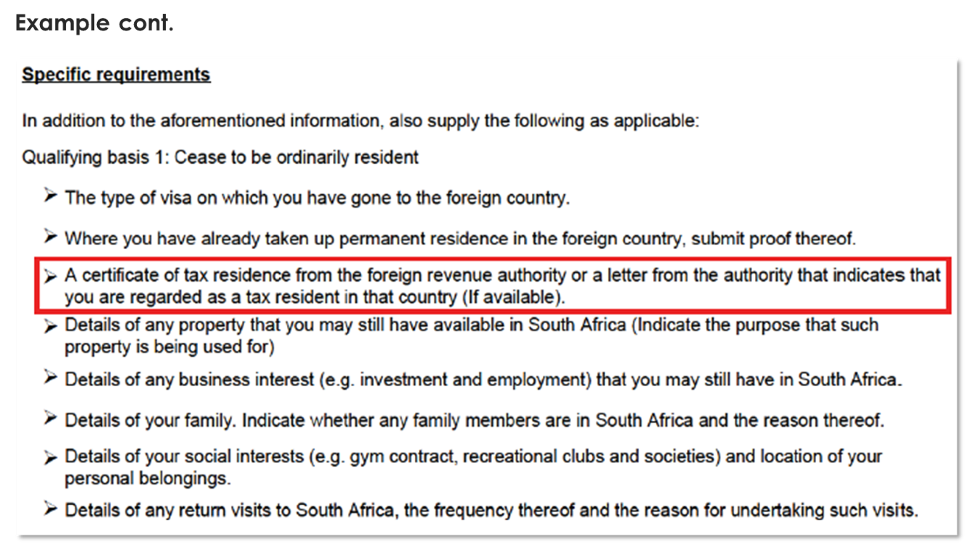
CONFIRMATIONS
OCTOBER 2022 | ALL RIGHTS RESERVED
HOSTED BY:

Slide 20
CONFIRMATIONS
OCTOBER 2022 | ALL RIGHTS RESERVED
HOSTED BY:

Slide 21
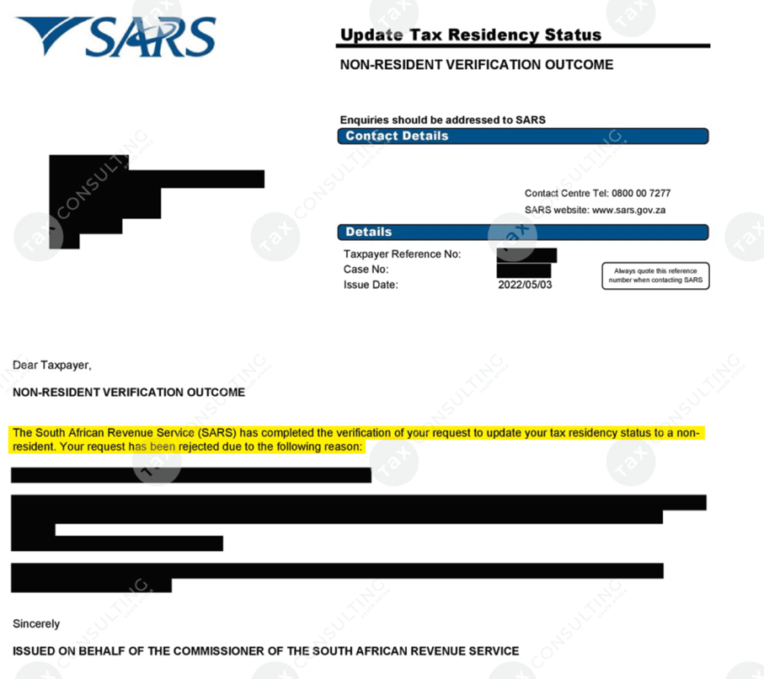
REJECTION
OCTOBER 2022 | ALL RIGHTS RESERVED
HOSTED BY:

Slide 22
CEASE TAX RESIDENCY | FINANCIAL EMIGRATION VS DTA
Financial emigration (“FE”) vs DTA exemption
FE once-off process, bank account status change and can withdraw RSA retirement interests, provided with a TCS PIN.
DTA annual process including obtaining residency certificate, SARS challenge per tie-breaker test, bank account unchanged, no retirement withdrawal.
Where is it the same?
CGT deemed disposal (“exit tax”) for both;
No world-wide income (RSA-sourced income only and RSA fixed property CGT);
Can own assets, including properties, send money home;
Can return one day (with a reason if post-FE), have holidays in South Africa;
May keep passport, keep policies and medical aid etc.
OCTOBER 2022 | ALL RIGHTS RESERVED
HOSTED BY:

Slide 23
‘EXIT TAX’| SECTION 9H OF THE INCOME TAX ACT
In the event of a cessation of tax residence, deemed disposal rules will take effect in order to prevent tax avoidance. Where a natural or legal person is not resident in the Republic, a liability in respect of CGT (Capital Gains Tax) will arise where a CGT event (a disposal or a deemed disposal) occurs.
Items included in the exit tax are inter alia:
Foreign fixed property;
Shares;
Unit trusts and other similar investments; and
Trusts – depending on how they are set up and what is contained in them.
Items excluded in the exit tax are inter alia:
South African fixed property in your own name;
Retirement funds such as pension, provident, retirement annuity; and
Cash.
OCTOBER 2022 | ALL RIGHTS RESERVED
HOSTED BY:

Slide 24
3-YEAR “LOCK-UP” ON PENSION FUNDS | WITH EFFECT FROM
1 MARCH 2021
Retirement Funds in South Africa:
Pension Preservation Fund;
Provident Preservation Fund; and
Retirement Annuity Fund.
OCTOBER 2022 | ALL RIGHTS RESERVED
HOSTED BY:

Slide 25
OUR APPROACH-WHY IT IS BENFICIAL TO FORM A STRATEGIC PARTNERSHIP |THE FINANCIAL EMIGRATION PROCESS
How we assist fellow professionals and their clients:
Free consultation & presentation to client.
Determination of facts.
Diagnostic process (trusts, assets, historic returns)
Execute application.
Liaise with banks / financial institutions on behalf of practitioner / client.
George branch expedites SARS administration.
Issuing of Non-resident confirmation letter and Tax Compliance Pin for Emigration upon finalization of process.
Future tax planning & encashment of policies.
OCTOBER 2022 | ALL RIGHTS RESERVED
HOSTED BY:

Slide 26
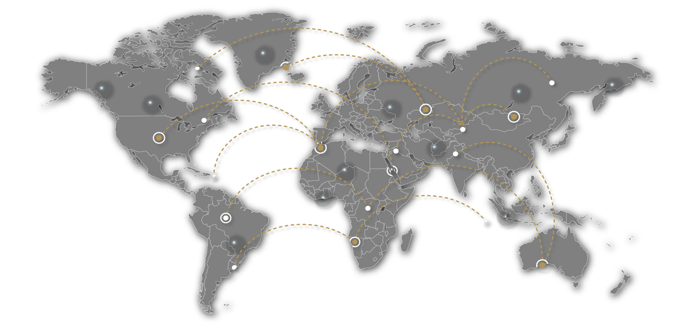
OUR GLOBAL FOOTPRINT
Our global footprint stretches over all 7 continents, as well as a key focus on all 54 African Countries, with industry leading professional partners in each jurisdiction.

Slide 27
THANK YOU
MARTIN BEZUIDENHOUT
martin@financialemigration.co.za
+27 84 418 3841

