Slide 1
WELCOME
ALLOWING 2 MINUTES FOR ATTENDEES TO JOIN

Slide 2
JUNE
2023
THE NEW SARS PROCESS
FOR INTERNATIONAL TRANSFERS
PRESENTED BY:
JASHWIN BAIJOO

Slide 3
AGENDA
1
Background & How it was announced
2
Criminal Sanctions
3
Supporting Documents
4
Practical Step-by-step
5
Examples Of Certificates
6
Q&A

Slide 4
GROUND RULES
By default, all attendees' videos are off and mics muted.
Any technical difficulties must be communicated in the chat section.
There will be a poll at the end of the webinar. Answers are strictly confidential.
Keep webinar engaging – please submit your questions and we address at the end of the webinar.
Presentation will be sent to attendees after event.

Slide 5
GENERAL COMMENTS
Good to do session again with SA Chamber members and following the roadshow last year!
High-level overview of the new SARS Approval International Transfer “AIT” - the enhanced TCS process that consolidates the FIA and Financial Emigration into a single application.
Important to understand that Government is "following the money". SARS is being clever in their approach to track down non-compliance with an effective self-audit – following the money trail.
Sharing what we encounter as one of South Africa’s largest 6 tax providers and for the benefit of wider market becoming smarter together.
JULY 2023 | ALL RIGHTS RESERVED
HOSTED BY:

Slide 6
“
Judge Dennis M Davis, Chairman Davis Tax Committee, is quoted saying:
“In summary, the second edition of this carefully considered book (which not only deals with all the various tax implications of immigration/emigration but the taxation of residents working offshore) remains an invaluable guide to an increasingly complex set of tax challenges. Given these changes, it is an even more significant addition to our body of tax literature and will remain essential reading for anyone advising his or her client with regard to the tax consequences of migration and non-resident accruals.”
OUR GLOBAL FOOTPRINT
Our global footprint stretches over all 7 continents, as well as a key focus on all 54 African Countries, with industry leading professional partners in each jurisdiction.

Slide 7
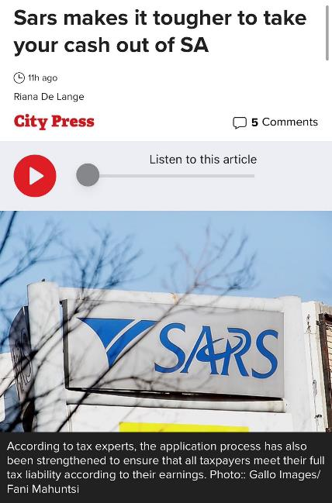
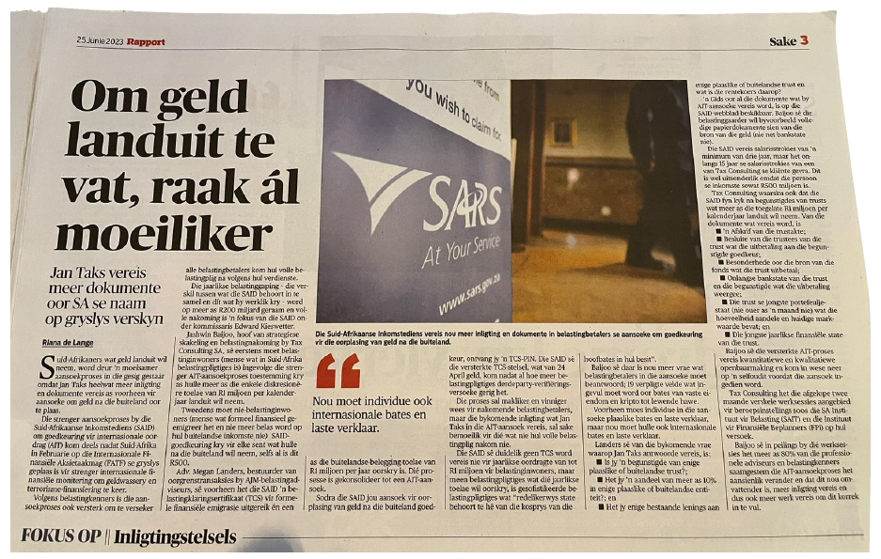
BIG NEWS | RAPPORT & CITY PRESS

Slide 8
MEET THE SPEAKER

Slide 9
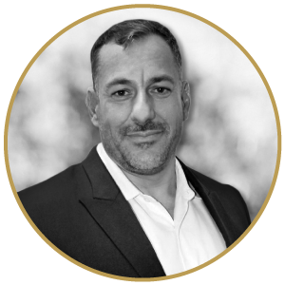
THE SPEAKER
JASHWIN BAIJOO
Head of Strategic Engagement & Compliance
Jashwin Baijoo is the Head of Strategic Engagement and Compliance. He holds both an LLB, and LLM degree, specialising in International Tax and Business Law. Jashwin has 5 years of legal experience in various aspects of South African and international law.
He is an admitted attorney of the High Court of South Africa with both practical litigation and consulting experience. He has worked in law firms focusing on dealing with litigation and commercial disputes. Jashwin moved from the pure practice of law to the consulting industry and has entrenched himself within tax law, specifically dealing with the elements of cross-border taxation, corporate incorporations and compliance, and international regulatory applications.
JULY 2023 | ALL RIGHTS RESERVED
HOSTED BY:

